Slide 1
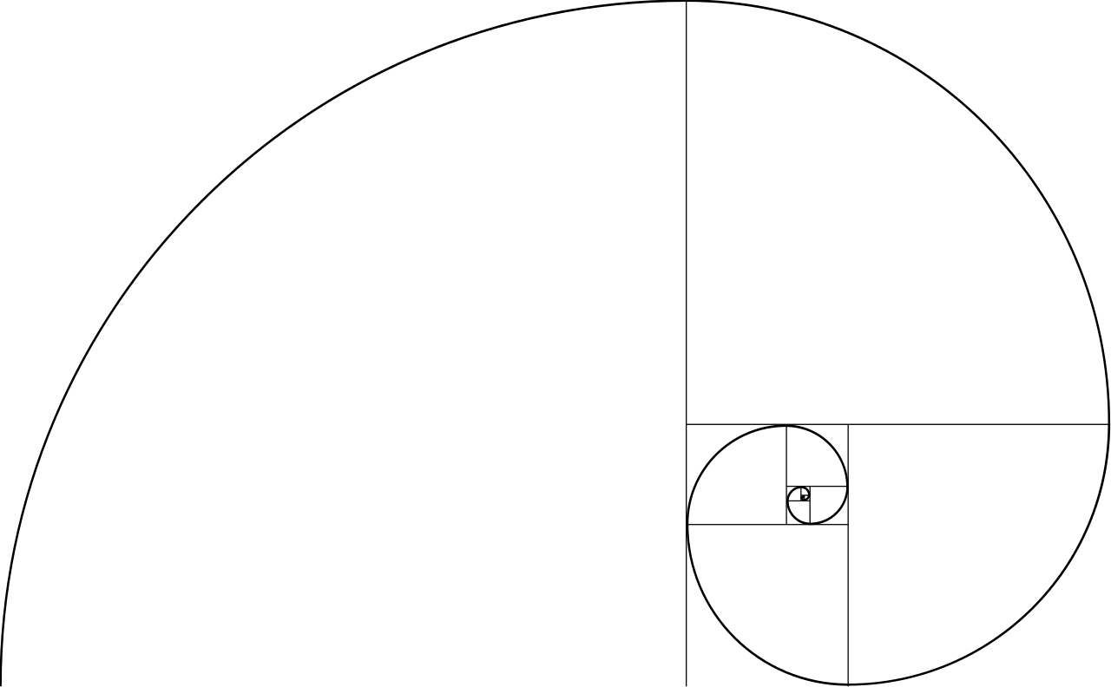
UX

Slide 2
User Experience
Clarity of purpose
Well organized message
Detailed description of your audience (a persona)
Compelling design
Delightful interaction
Useful

Slide 3
Content Comes First
What are you communicating?

Slide 4
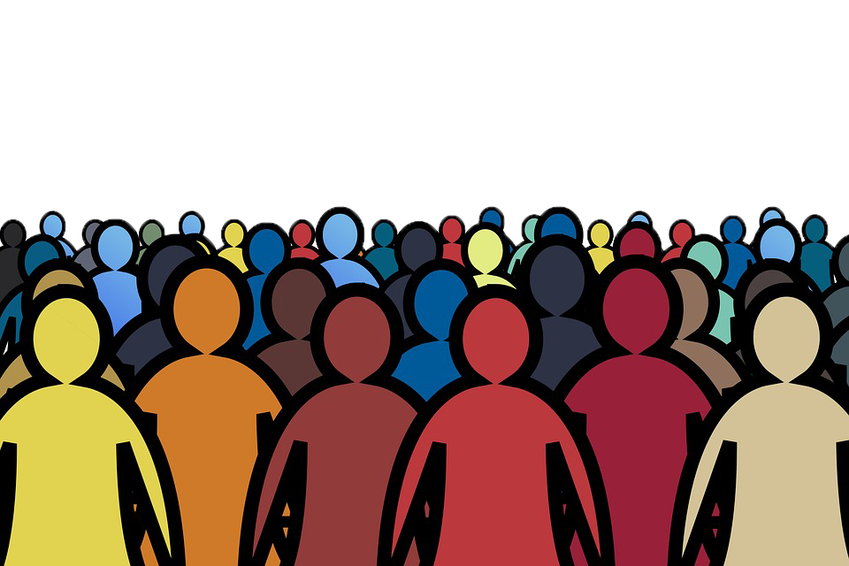
Or Audience Comes First
Who are you
communicating
with?

Slide 5
A persona is a research-based document that describes a typical person that you’re targeting or who uses your product
Source: https://forumone.com/ideas/elements-of-a-persona
Notes:
https://forumone.com/ideas/elements-of-a-persona
https://docs.google.com/spreadsheets/d/1fN-TCRV0gsuMQhTJ3ibKxlCVOeyzJNi7cTn_qmp4qws/edit?usp=sharing
https://careerfoundry.com/en/blog/ux-design/how-to-define-a-user-persona/
https://www.usability.gov/how-to-and-tools/methods/personas.html

Slide 6
< == >
Notes:
LESS IS MORE
Don’t fear whitespace
Remove Barriers
Strive for Simplicity

Slide 7

Notes:
LESS IS MORE
Don’t fear whitespace
Remove Barriers
Strive for Simplicity

Slide 8
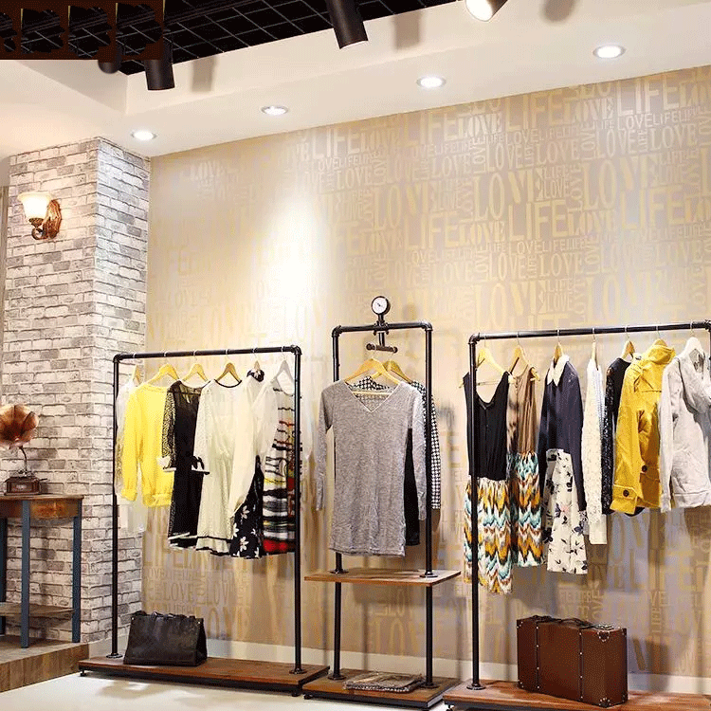
Notes:
LESS IS MORE
Don’t fear whitespace
Remove Barriers
Strive for Simplicity

Slide 9
Be Consistent
==
Notes:
Keep layout and branding constant between pages

Slide 10
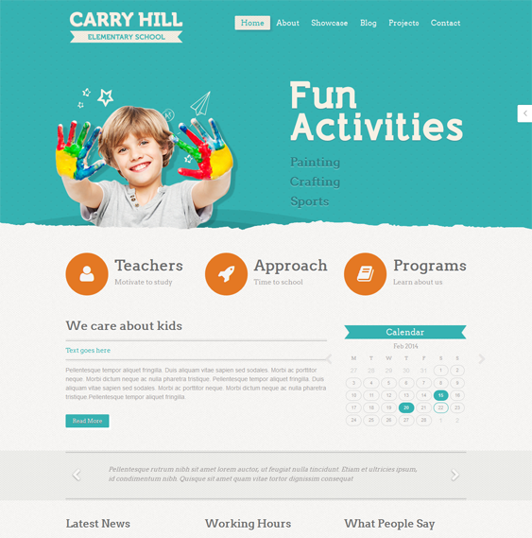

Notes:
Keep layout and branding constant between pages

Slide 11
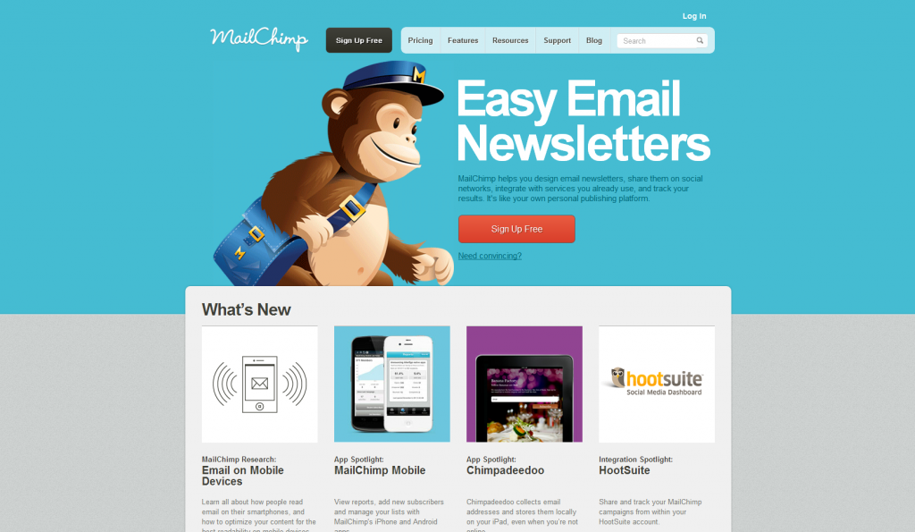
Notes:
Keep layout and branding constant between pages

Slide 12
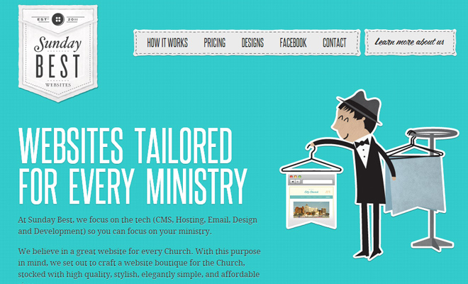
Notes:
Keep layout and branding constant between pages

Slide 13

Call To Action
Notes:
Call to action

Slide 14
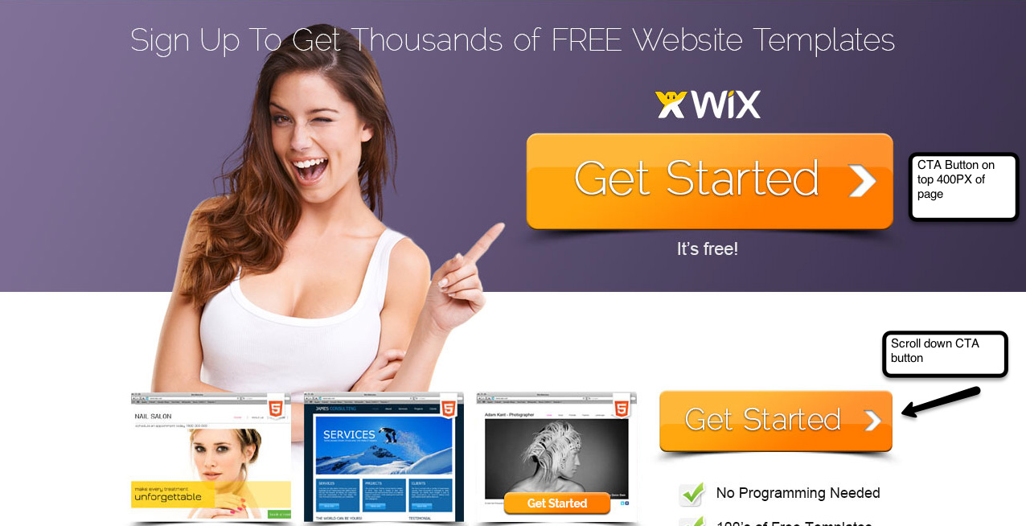
Notes:
Call to action

Slide 15
Navigation Best Practice
Visual Clues
Chunking
Signpost
Sitemap (footer?)
Search

Slide 16
Navigation Structure
PRIMARY
VERBS - task based nav
NOUNS - category based
AUDIENCE - What audience to you belong?
SECONDARY
Popularity
Promotion
Location
Time
Alphabetical
Order
Notes:
http://www.awwwards.com/websites/navigation/
http://www.dtelepathy.com/blog/inspiration/23-great-examples-of-innovative-navigation-for-your-inspiration

Slide 17
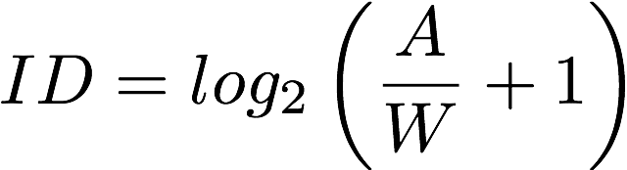
Notes:
Fitts Law - http://simonwallner.at/ext/fitts/
https://en.wikipedia.org/wiki/Fitts%27s_law
itts's law (often cited as Fitts' law) is a descriptive model of human movement primarily used in human–computer interaction and ergonomics. This scientific law predicts that the time required to rapidly move to a target area is a function of the ratio between the distance to the target and the width of the target.^{[1]} Fitts's law is used to model the act of pointing, either by physically touching an object with a hand or finger, or virtually, by pointing to an object on a computer monitor using a pointing device.
Fitts's law has been shown to apply under a variety of conditions, with many different limbs (hands, feet,^{[2]} the lower lip,^{[3]} head-mounted sights,^{[4]} eye gaze^{[5]}), manipulanda (input devices^{[6]}), physical environments (including underwater), and user populations (young, old, special educational needs, and drugged participants).

Slide 18
Hierarchy & Order
Notes:
Every page should have...
What is your site about. Can you write a short sentence to say what your site is about?
Tagline - make sure it's text not an image "Ventura Area Flowers Delivered for all life's special events"
Product and geographical area are the most important thing to include
Make logo a home page link
The Title
Descriptive text should go in the title
Lead with the most important information 64 characters max
Use the reverse of breadcrumbs - most specific first - Use the pipe to separate terms
Category pages help people get to the information they need.
Should have a short introduction Should include related links page

Slide 19
People Don’t Read
They scan
Notes:
http://www.awwwards.com/6-web-design-trends-you-must-know-for-2015-2016.html
http://www.webdesignerdepot.com/2015/01/4-essential-layout-trends-for-2015/
https://visualhierarchy.co/blog/popular-web-design-trends-2015/
https://webflow.com/blog/17-web-design-trends-for-2016

Slide 20
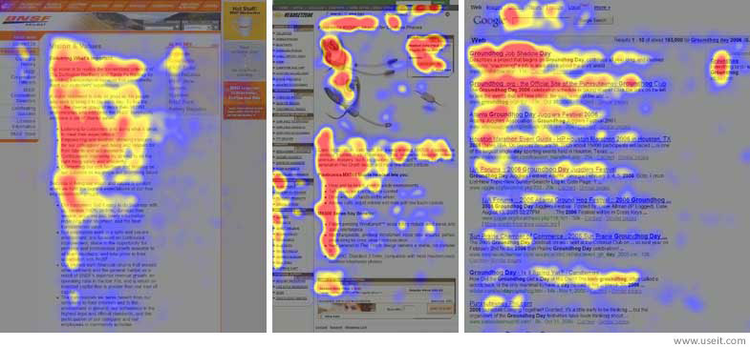
Notes:
https://www.nngroup.com/articles/f-shaped-pattern-reading-web-content/
The F pattern
First paragraphs get the most attention.
First 11 letters are the most scanned
Put a summary of the pages content in the first paragraph
Make sure that page headings convey useful information
Front load headings and bullet point with information-carrying words
People with lower literacy read every word - others don't.
Keep it short and simple.
People read 20% slower and 20% less
Cut out 50% of the words - ironically visitor's perception goes up.
think short. Short paragraphs/short words/short pages
Your credibility as a web designer has a lot to do with you ability to write simple text
Daniel Oppenheimer - 2006 - found that the more complex a piece of text was, the lower readers rated the intelligence of the author.
heading and sub-headings are the main things people scan. Make sure they're summaries.
Never use more than 3 levels of headings.
Use summaries for each page.
Inverted pyramid - users can stop at any point and still have the entire story.
Start with the conclusion.
Use bulled or numbered lists
only use numbers for ordered lists
Users love lists - put keyword first
Links stand out on the page. Its a way of highlighting key text.
Clear Headings, informative summaries, concise body text.

Slide 21
Trends in Hierarchy
https://www.awwwards.com/web-design-trends-for-2017.html
https://blog.hubspot.com/marketing/web-design-trends-2017
http://www.awwwards.com/6-web-design-trends-you-must-know-for-2015-2016.html
http://www.webdesignerdepot.com/2015/01/4-essential-layout-trends-for-2015/
https://visualhierarchy.co/blog/popular-web-design-trends-2015/
https://webflow.com/blog/17-web-design-trends-for-2016
Notes:
https://www.awwwards.com/web-design-trends-for-2017.html
https://blog.hubspot.com/marketing/web-design-trends-2017
http://www.awwwards.com/6-web-design-trends-you-must-know-for-2015-2016.html
http://www.webdesignerdepot.com/2015/01/4-essential-layout-trends-for-2015/
https://visualhierarchy.co/blog/popular-web-design-trends-2015/
https://webflow.com/blog/17-web-design-trends-for-2016

Slide 22
The language you use is very important
The more complex the text,
the lower readers rated
the intelligence of the author.
Daniel Oppenheimer - 2006

Slide 23
The Splash Page
Is Dead
Notes:
Home page should be your site summary
Tell user what the site does - what is your audience's need?
Homepage is where you welcome users with fresh content
Orient users with high-level information
provide links to top tasks
Use summary text
Navigation menu should be a way for visitors know what the site is about.
Be consistent
5 second test - can visitors say what your site is about?

Slide 24
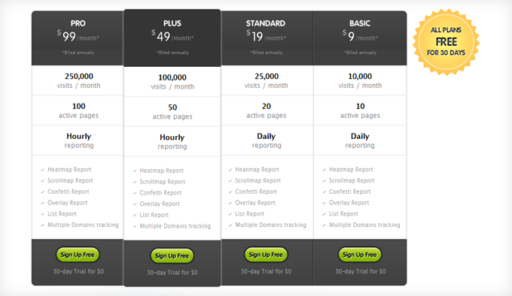
Comparison Tables
Help people choose
Notes:
http://www.incomediary.com/best-designed-pricing-comparison-tables
http://designwoop.com/2012/04/20-examples-of-perfectly-designed-comparison-tables/
https://www.smashingmagazine.com/2008/10/pricing-tables-showcase-examples-and-best-practices/

Slide 25
The Landing Page
Is In
Notes:
http://unbounce.com/landing-page-articles/what-is-a-landing-page/
http://thelandingpagecourse.com/landing-page-101-intro/

Slide 26
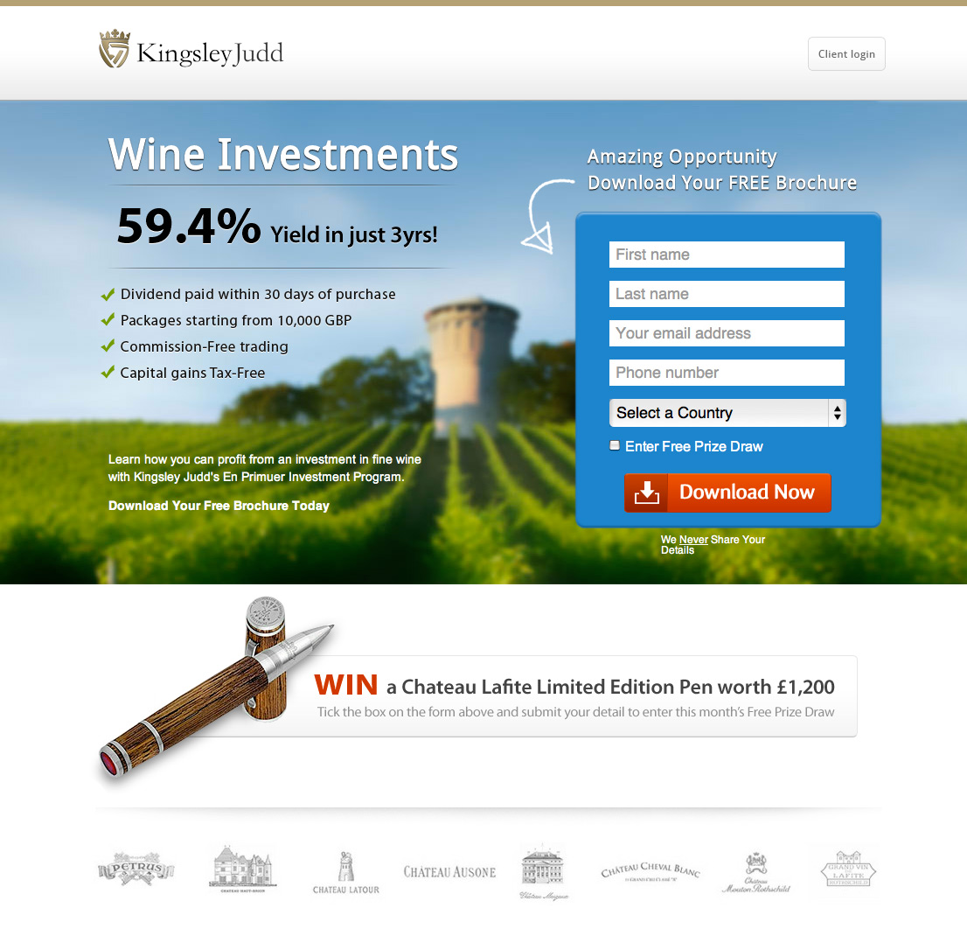
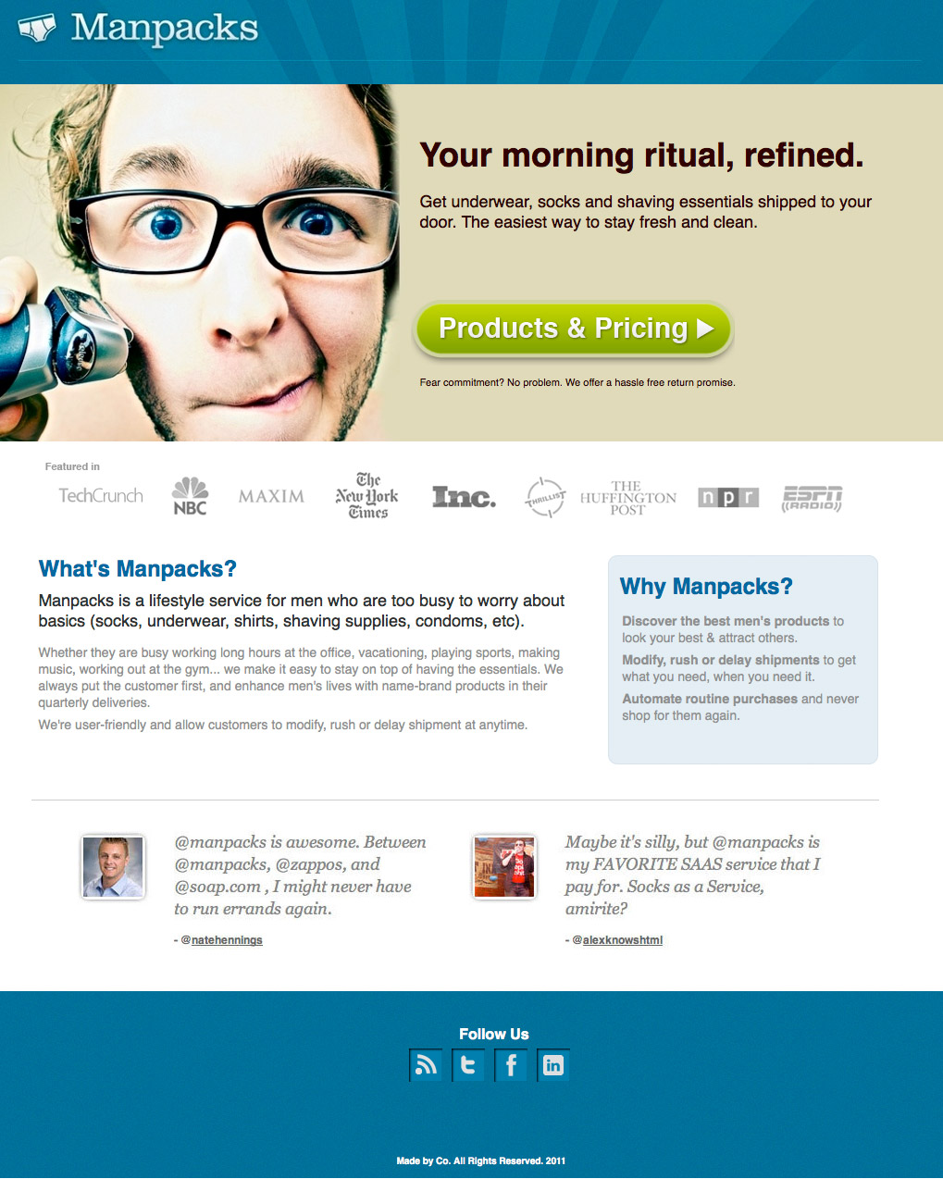
Notes:
http://unbounce.com/landing-page-articles/what-is-a-landing-page/
http://thelandingpagecourse.com/landing-page-101-intro/

Slide 27
about us
==
can I trust you?
http://blog.hubspot.com/marketing/remarkable-about-us-page-examples
https://www.searchenginejournal.com/25-creative-and-engaging-about-us-pages/
Notes:
http://blog.hubspot.com/marketing/remarkable-about-us-page-examples
https://www.searchenginejournal.com/25-creative-and-engaging-about-us-pages/

Slide 28
https://www.smashingmagazine.com/web-form-design-showcases-and-solutions/
https://www.uxpin.com/studio/blog/web-form-design-best-practices-5-useful-ui-patterns-2/
http://mono.company/journal/design-practice/the-10-commandments-of-good-form-design-on-the-web/
http://www.awwwards.com/25-impressive-contact-forms.html
User
Input
Notes:
https://www.smashingmagazine.com/web-form-design-showcases-and-solutions/
https://www.uxpin.com/studio/blog/web-form-design-best-practices-5-useful-ui-patterns-2/
http://mono.company/journal/design-practice/the-10-commandments-of-good-form-design-on-the-web/
http://www.awwwards.com/25-impressive-contact-forms.html
Forms
does your user know whey they're giving information.
make it as painless as possible.
removing barriers increases viewership
What will they get for what they give
People don't like filling out forms.
Ask the smallest number of questions possible.
Ask sensible questions
Use headings and sub-headings - what you're asking for and why.
---
Give visitors different length fields to help them determine what they're filling out.
Radio buttons - only one can be pushed - car radio buttons
Be sure the text is clickable too.
Labels go to the right - each option goes on it's own line.
put help text on the form.
Do not put a reset button on the form.
Submit should say "Register" or "Email" or "Request Information"
provide a confirmation screen.
Form errors
Error on each line.
Errors as they go.
Add error message on each

Slide 29

Notes:
A picture is worth 1000 words
Think about the purpose of every image on your page. Do you need a video.
page load time is just as important now as it has been in the past
Does the multimedia send a message - does it enhance the experience
provide useful information
Don't auto play - clear play and mute button
simplify the user experience
help users understand what your site is about with decoration
stock photography - decreases website reputation

Slide 30
UX
THE BEST
Notes:
http://webbyawards.com/winners/2015/websites/website-features-and-design/best-user-experience/
http://webbyawards.com/winners/2016/websites/website-features-and-design/best-user-experience/
http://www.webdesignerdepot.com/2013/07/15-web-sites-with-excellent-ux/
http://www.dtelepathy.com/blog/inspiration/15-interactive-websites-with-engaging-user-experiences

